Slide 1


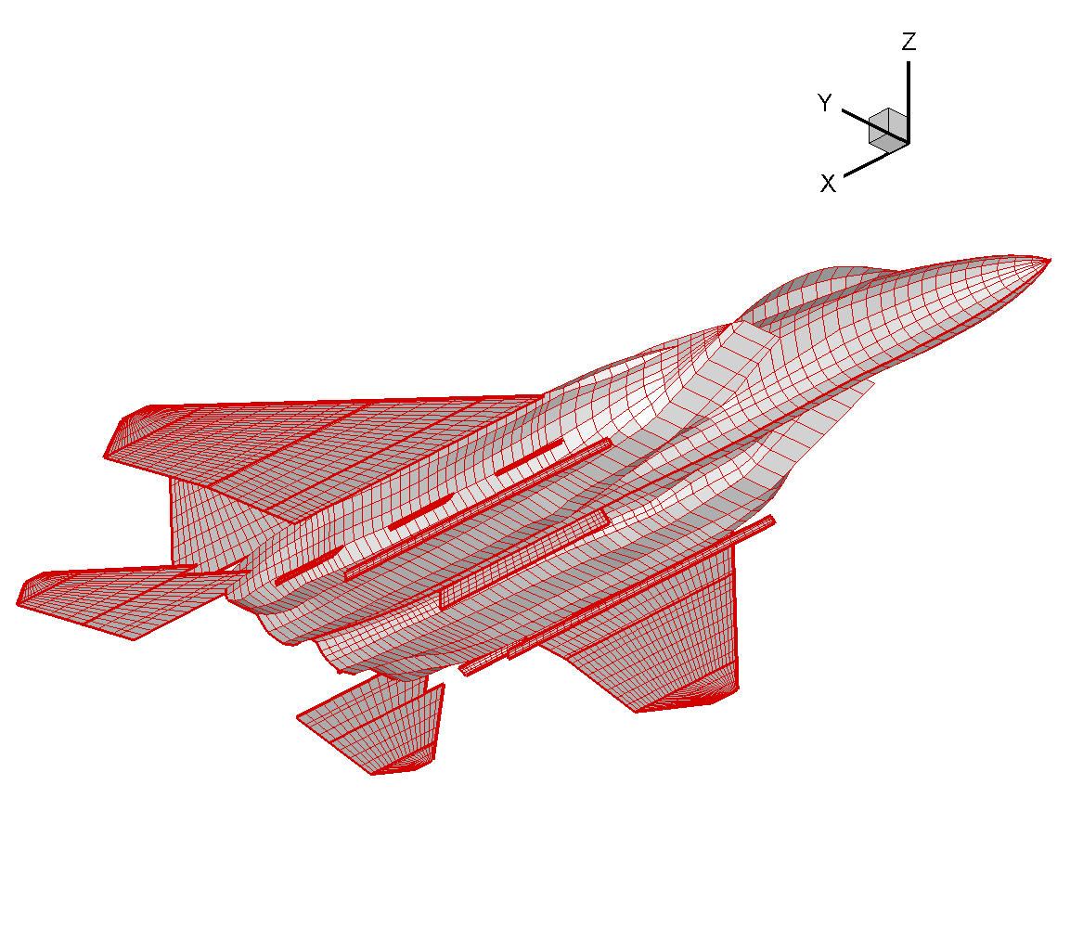
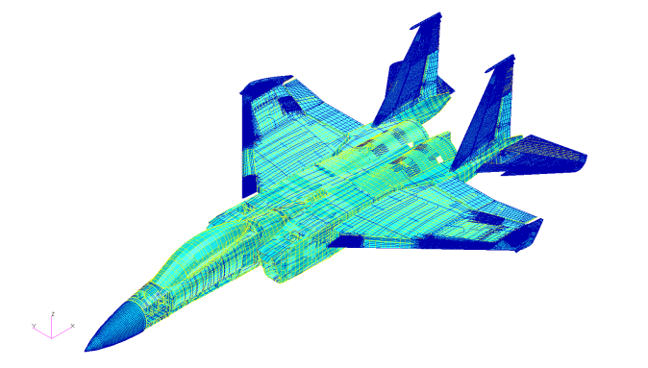
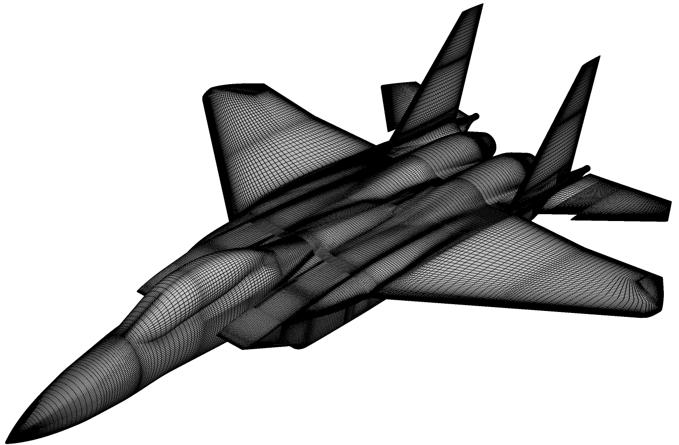
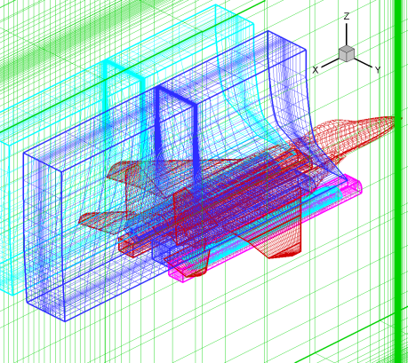


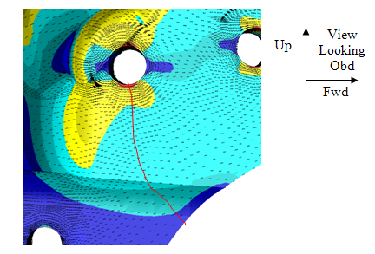
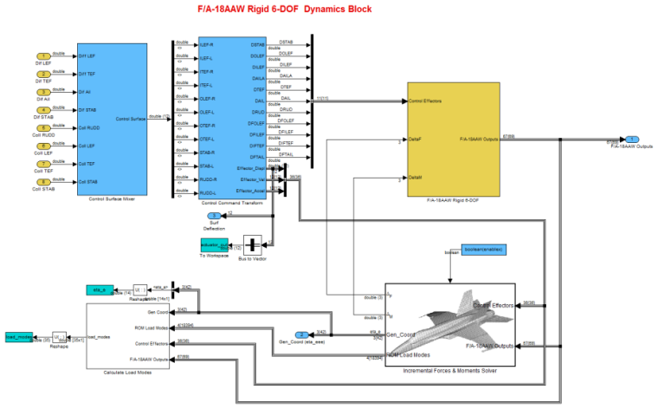
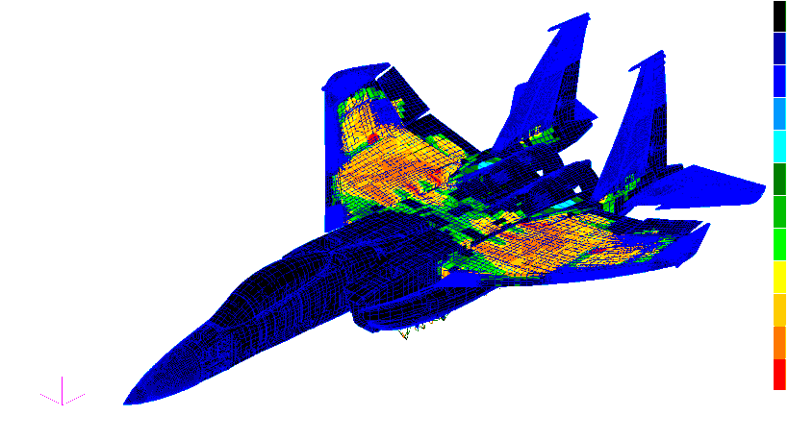
Stick-to-Stress Real-time Simulator (StS-RtS) Application
ASE Simulation Workshop hosted by NASA at National Institute of Aerospace
Hampton, VA Ned Lindsley, AFRL/RBS 18 Apr 2012

Slide 2
StS-RtS Outline
What is it?
A Physics Preserving, Real-time 6-DOF Simulation Tool for an Aeroelastic Vehicle, from Pilot Input to Global Airframe Stress
Includes Sensors, Control Surface Freeplay and Gust
Where did it come from?
Streamlined Stores Clearance (ZEUS, NICE Online Tools)
Dynamic Flight Simulator (Linear, NASA Dryden SBIR & Northrop)
Why is it here?
Generate Comprehensive Representative Dynamic Stress Histories
What else is it?
Prototype Development, Pilot Training, CLAW Evaluation
What else can it be?
Pilot Variation, Stores Configuration, Uncertainty Quantification

Slide 3
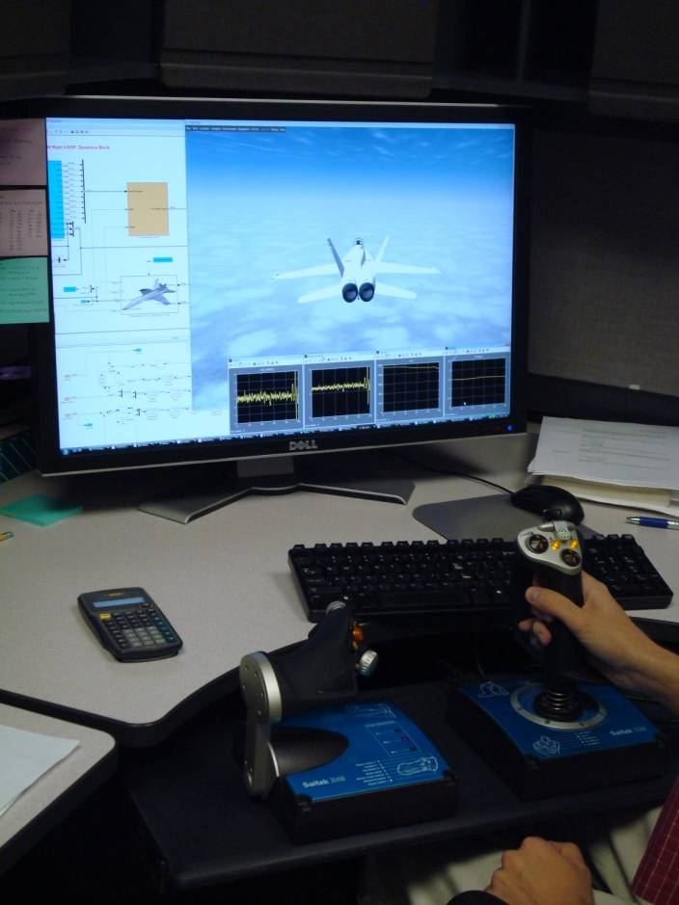
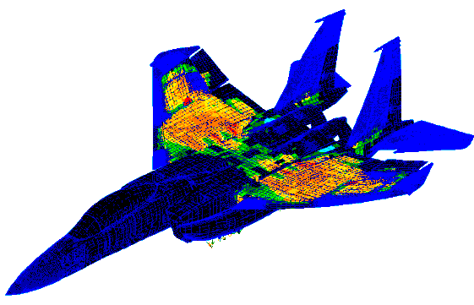
StS-RtS Process Overview
Seamless Fidelity Transition, Panel to Overset Euler
Detailed OML
Detailed Surface Panel Model
Detailed GLOBAL FEM Stress & Dynamics
Modes
Slice
& Dice
ZEUS Auto-Mesh
Full AV Stress
Cp ROMs
GAF ROMs
Batch or Stick Input
Detailed LOCAL “Breakout” Stress FEM for DADT
Real-time Surface
Pressure History
Detailed GLOBAL Dynamic Stress FEM
MODSDF-StS
via Simulink
Stress as a BC
Crack Growth
Detailed Mission-Vehicle-Pilot-Specific Dynamic Stress Histories for Fatigue, DADT & Fleet Management Purposes, all via Real-time Euler-based Simulation

Slide 4
SSC Background
The Streamlined Stores Clearance product consists of three sub-programs
The Medium-Fidelity Flutter Analysis Tool (MEDFFAT) (Feb. 2005 – Dec. 2006)
The Real-time Nonlinear Analysis System (RETINAS) (Mar. 2005 – Oct. 2007)
The Nonlinear Interactive Clearance Environment Phase I (NICE) (Jun. 2007 – May 2009)
MEDFFAT developed an aeroelastic simulation tool to identify critical flutter/LCO cases from a massive number of fighter aircraft with store configurations.
Outcome of MEDFFAT was the OVERCAP (replaced by ZEUS) code that integrates the essential disciplines required for aeroelastic analysis.
RETINAS provided the flight-test engineer with an off-line flowfield/aircraft visual assessment capability ready for real-time diagnostics and decision-making.
Outcome of RETINAS is an off-line flowfield reconstruction & visualization software system.
NICE links the RETINAS tool with flight test software (Interactive Authoring Display System, IADS®, developed by Symvionics) to create an on-line capability.
The NICE tool takes the real-time IADS data stream and provides, in near real-time, visualizations of the vehicle aeroelastic response and the unsteady flowfield.

Slide 5

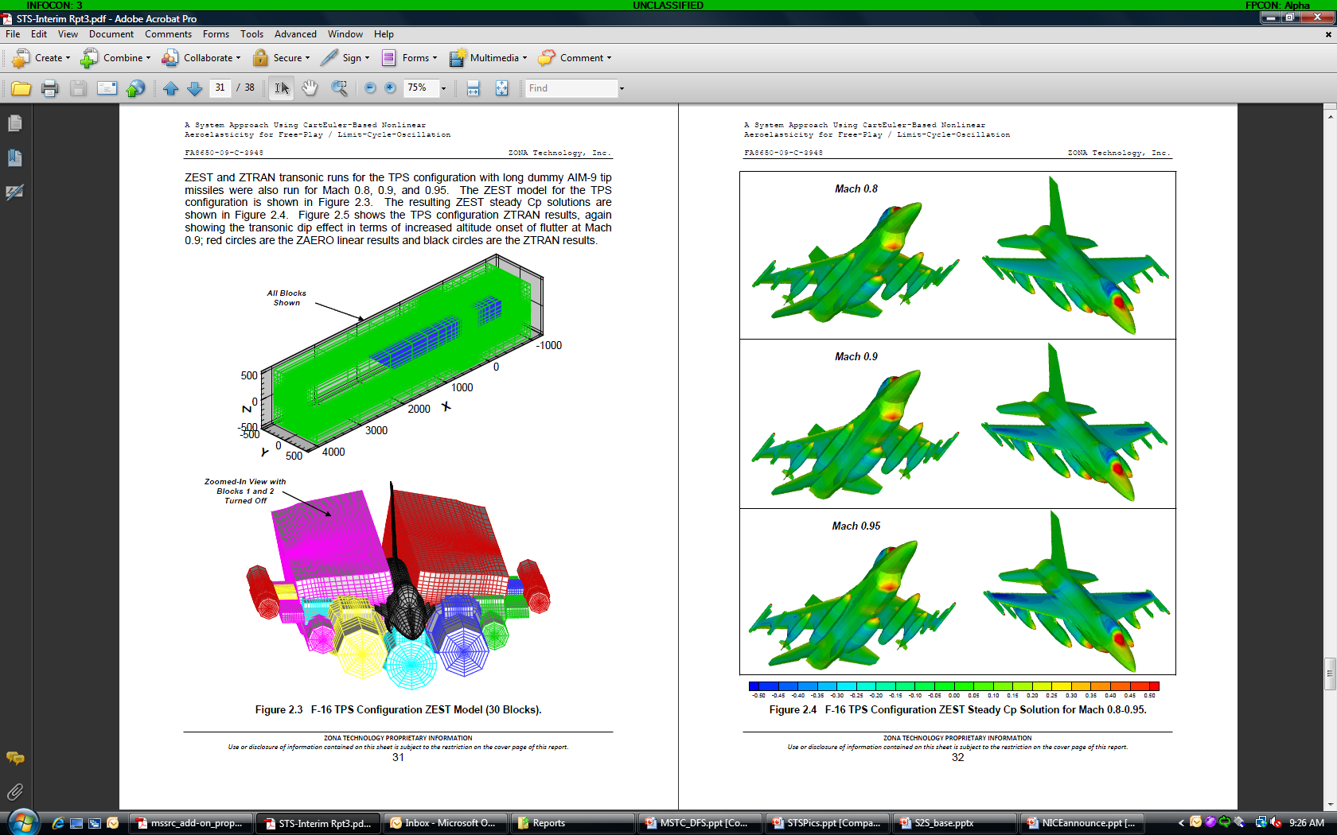
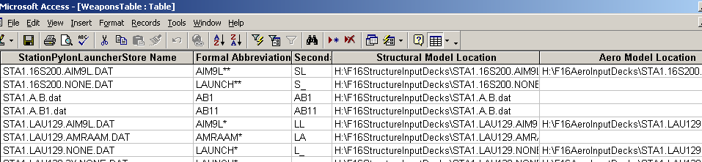
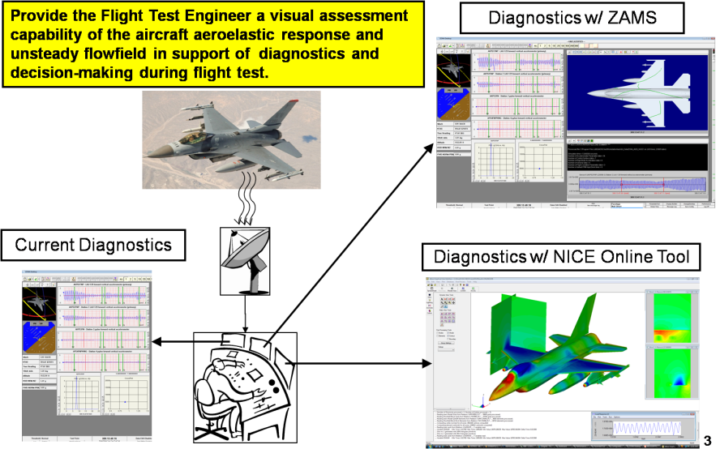
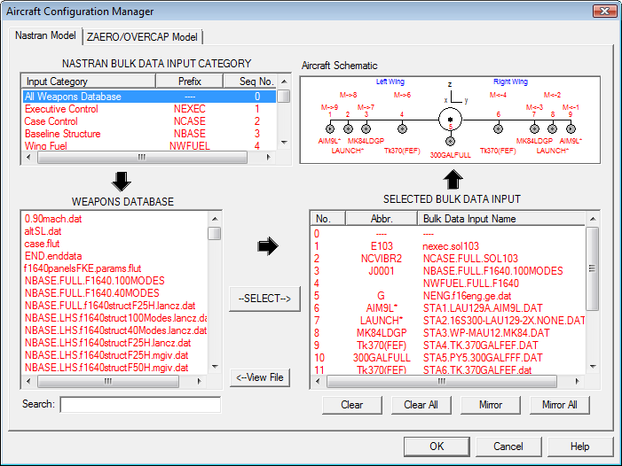
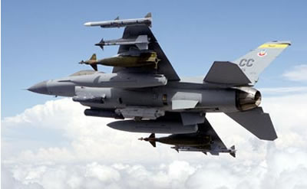
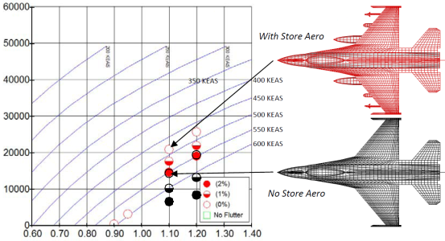
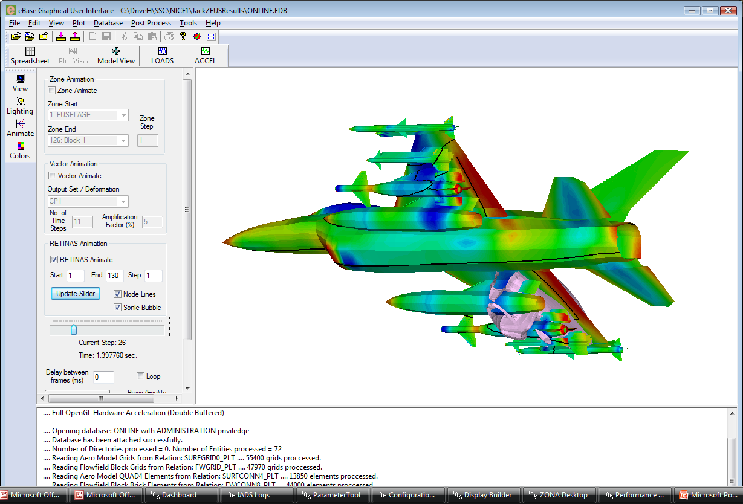

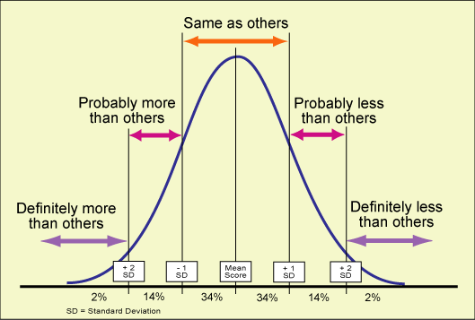
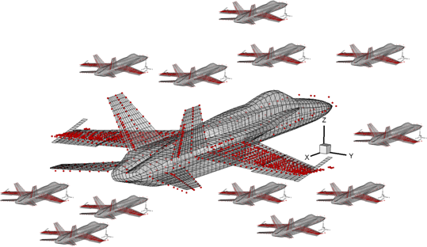
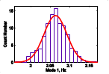
Streamlined Stores Clearance
World’s First Process for Store Carriage Certification Based on Euler-Fidelity Screening and Real-Time Surface Pressure Reproduction in the Control Room
In-House Uncertainty Quantification Effort Underway, Full Program 2014

Slide 6
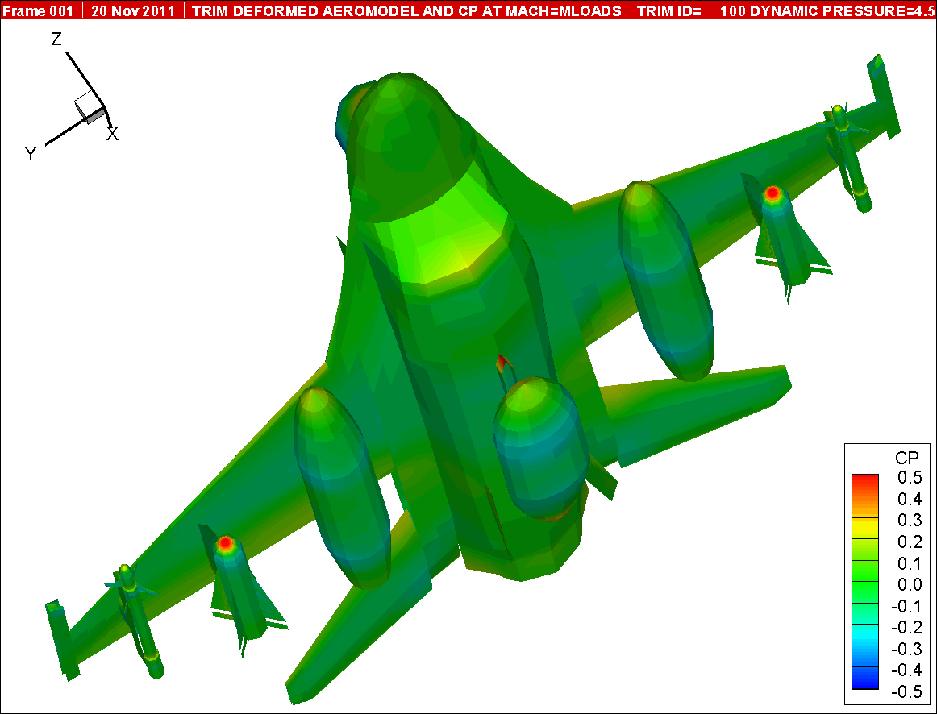
SSC-ZEUS, Direct Run
M=0.70, Alt=3,000 ft

Slide 7
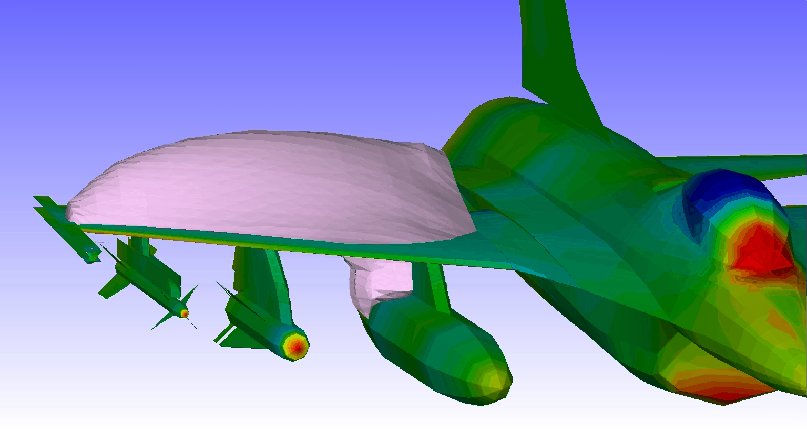
SSC-NICE, Sonic Bubble Vis 1
M=0.90, Alt=5,000 ft

Slide 8
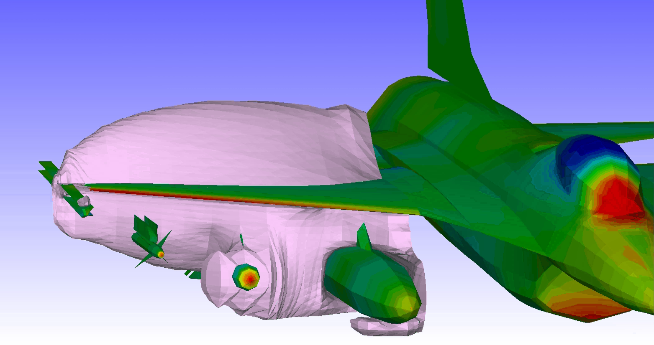
SSC-NICE, Sonic Bubble Vis 2
M=0.92, Alt=2,000 ft

Slide 9
Dynamic Flight Simulator, DFS
Combines flight dynamics and nonlinear aeroelastic models in the Simulink environment
Use ZEUS (a CFD code) to generate POD modes of the unsteady aerodynamic Cp, and generalized aerodynamic forces (GAFs)
Create Neural Net ROMs using ZEUS POD output as training data via MATLAB GUI program
NNET ROMs solved each time step in simulation to give unsteady Cp and GAFs, leading to incremental loads and control forces/moments, as well as accelerations and component loads at multiple locations
Unsteady Cp yields incremental loads history for Global Stress FEM
GAFs make rigid 6-DOF controller elastic using elastic control
Component Loads, compare to MODSDF, use in OFLCP, traditional
Predefined control inputs, or joystick for pilot-in-the-loop simulation
ΔF, ΔM

Slide 10
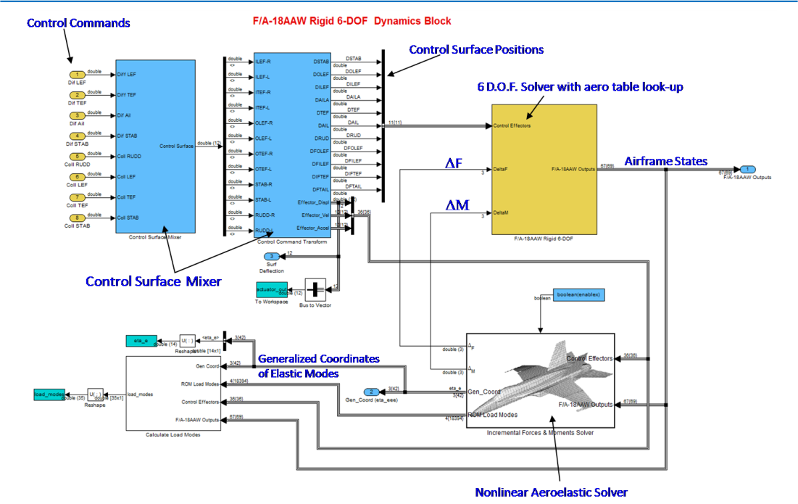
DFS

Slide 11
DFS
Unsteady aerodynamics computed by two-layer feed-forward Neural Network model:
Input U is the aeroelastic states η_{e} and output y is GAF
Each GAF is calculated by a separate Neural Net:
Solve for elastic states:
Another set of Neural Net ROMs calculate the distributed Cp
Integrating the Cp gives ΔF and ΔM

Slide 12
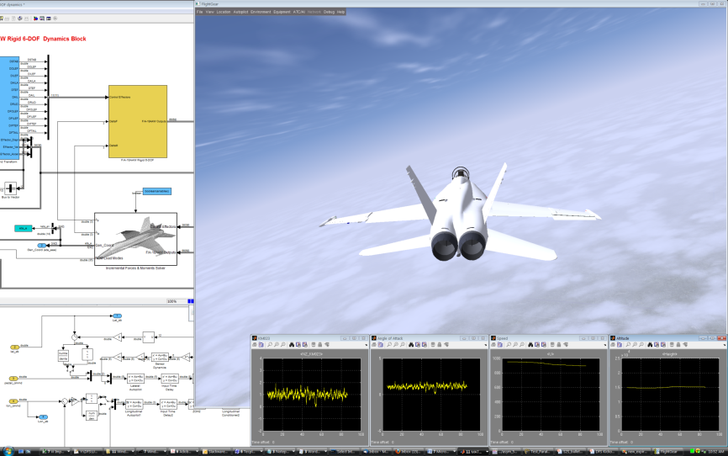
DFS
Select ROMs
H, M, α, β
ROM modal forces
Structural Modes Solver
GAF ROM
Elastic Modes
Other modal forces
C_{P} ROM
Component Loads
ΔF, ΔM
Incremental Sensor Calculation
Δ Sensor

Slide 13
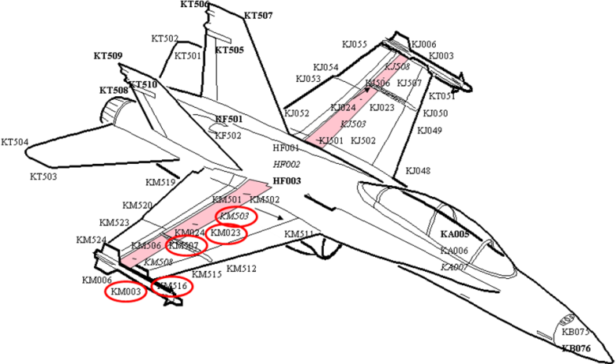
DFS
Vertical Acceleration at KM507 (wing fold)
Symmetric Aileron Excitation
Accelerometer Locations

Slide 14
MODular Six Degree Of Freedom, MODSDF
FEMS
Interface
subroutines (wing,
pylon, etc)
Loads WT
tests
Structural
stiffness
Aero WT
tests
Detailed
spec
Load aero
coeff’s
Aircraft
aero
Design
team input
Past
experience
Criteria
MODSDF
Load
surveys
Critical load/
Structure criteria
Mass
properties
Propulsion
Mil
specs
Control
laws
Design load
condition
Balance
process
FEMS
Pressure
data
Mass
data

Slide 15
MODSDF Overview
MODSDF predicts the trajectory and attitude of a vehicle in three dimensional space
A high fidelity, non-linear, stand-alone, simulation of vehicle motion that employs a fixed-step fourth-order Runge-Kutta integration scheme and six DOF algorithm
Structure allows project-specific analysis requirements to be incorporated while preserving the integrity and generic quality of its embedded methods
For example: Named pipes
Typical uses in St. Louis
Evaluations of Flight Control System Designs
Time-Dependent Flying Qualities and Performance Characteristics
Flight, Store, and Ground Loads
Weapons Separation Characteristics
Verification of Manned Simulator Models
Reproduction of Flight Anomalies for Incident/Accident Investigations

Slide 16
MODSDF-StS “Impacts”
FEMS
Interface
subroutines (wing,
pylon, etc)
Loads WT
tests
Structural
stiffness
Aero WT
tests
Detailed
spec
Load aero
coeff’s
Aircraft
aero
Design
team input
Past
experience
Criteria
MODSDF
Load
surveys
Critical load/
Structure criteria
Mass
properties
Propulsion
Mil
specs
Control
laws
Design load
condition
Balance
process
FEMS
Pressure
data
Mass
data

Slide 17
StS-RtS Process Overview
Seamless Fidelity Transition, Panel to Overset Euler
Detailed OML
Detailed Surface Panel Model
Detailed GLOBAL FEM Stress & Dynamics
Modes
Slice
& Dice
ZEUS Auto-Mesh
Full AV Stress
Cp ROMs
GAF ROMs
Batch or Stick Input
Detailed LOCAL “Breakout” Stress FEM for DADT
Real-time Surface
Pressure History
Detailed GLOBAL Dynamic Stress FEM
MODSDF-StS
via Simulink
Stress as a BC
Crack Growth
Detailed Mission-Vehicle-Pilot-Specific Dynamic Stress Histories for Fatigue, DADT & Fleet Management Purposes, all via Real-time Euler-based Simulation

Slide 18
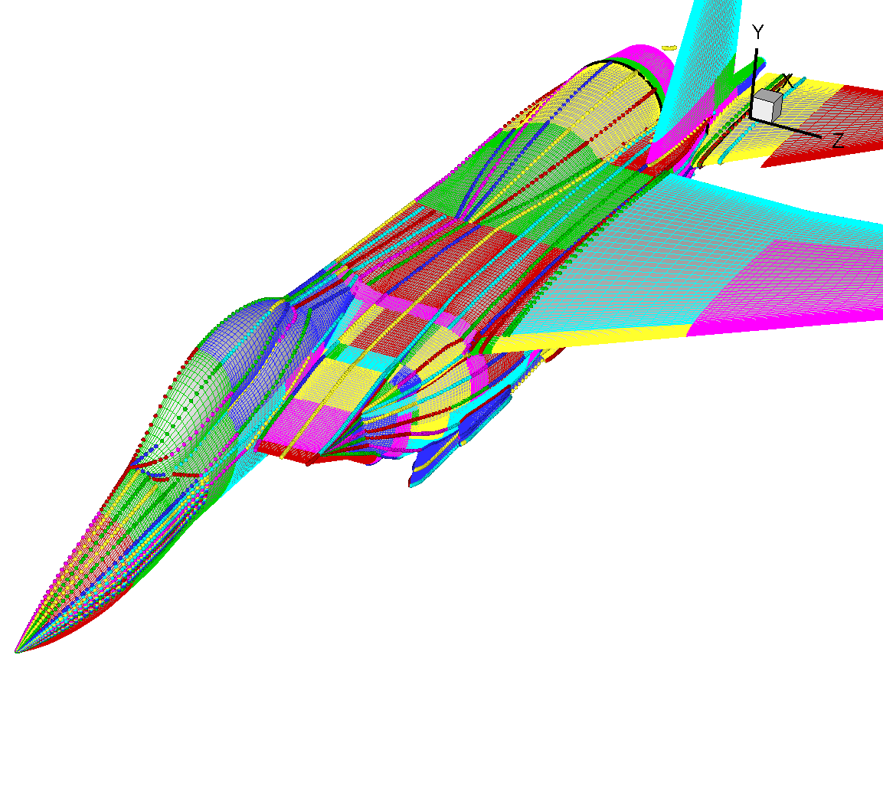
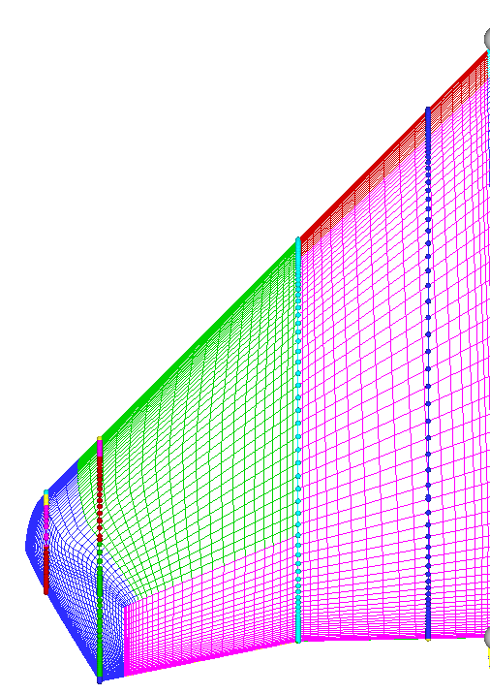
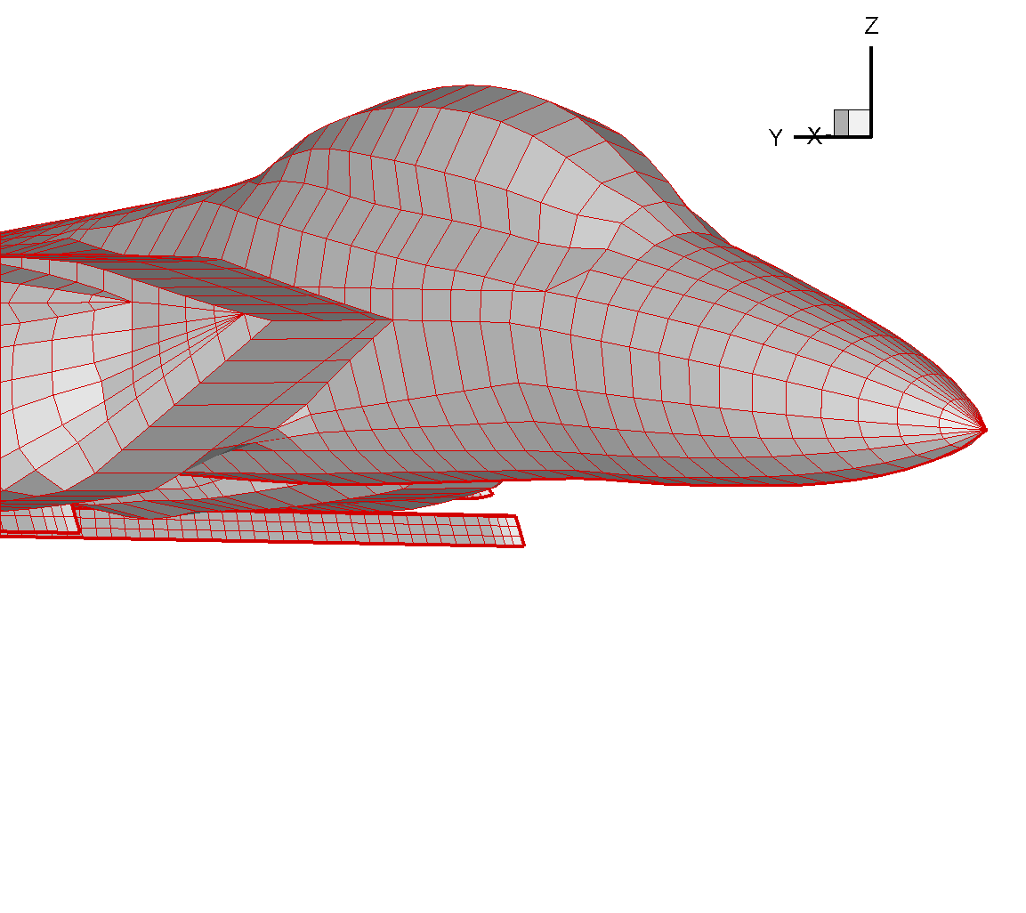
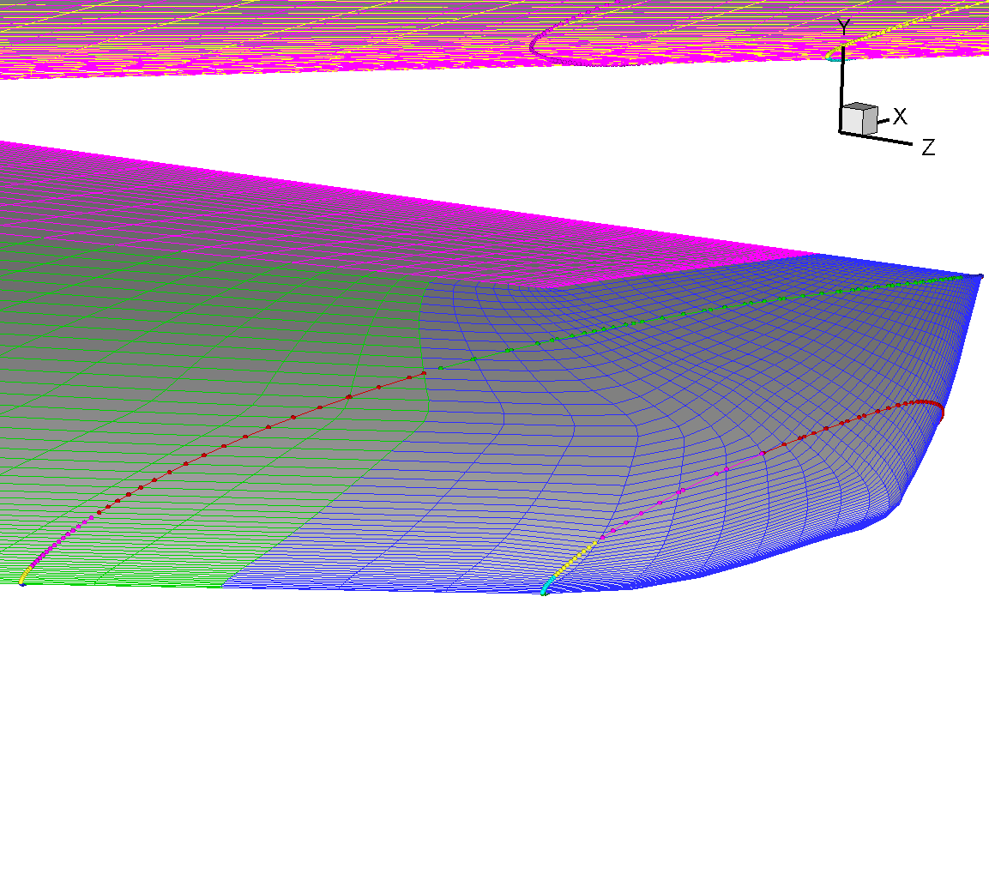
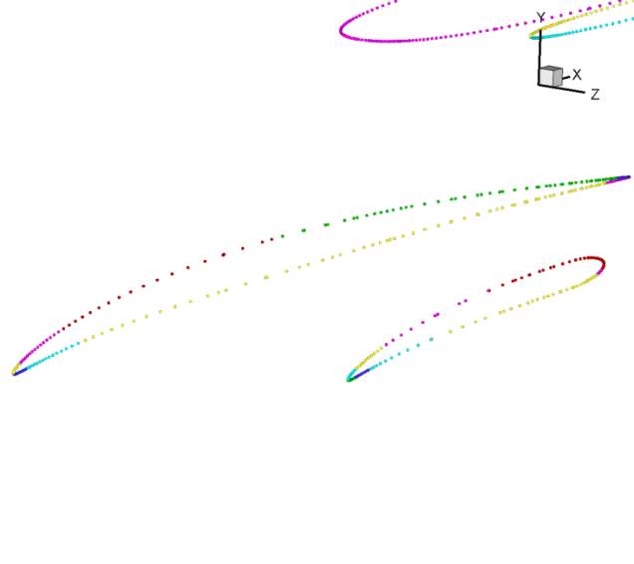
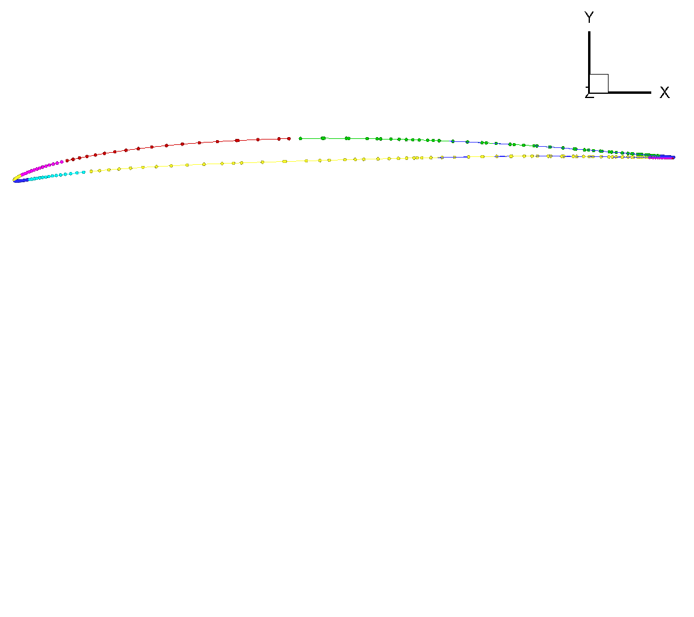
Detailed OML to Detailed Panel
Fuselage Slices in Tecplot
Detailed CFD OML
Wing Slices in Tecplot
Detailed Surface Panel Model

Slide 19
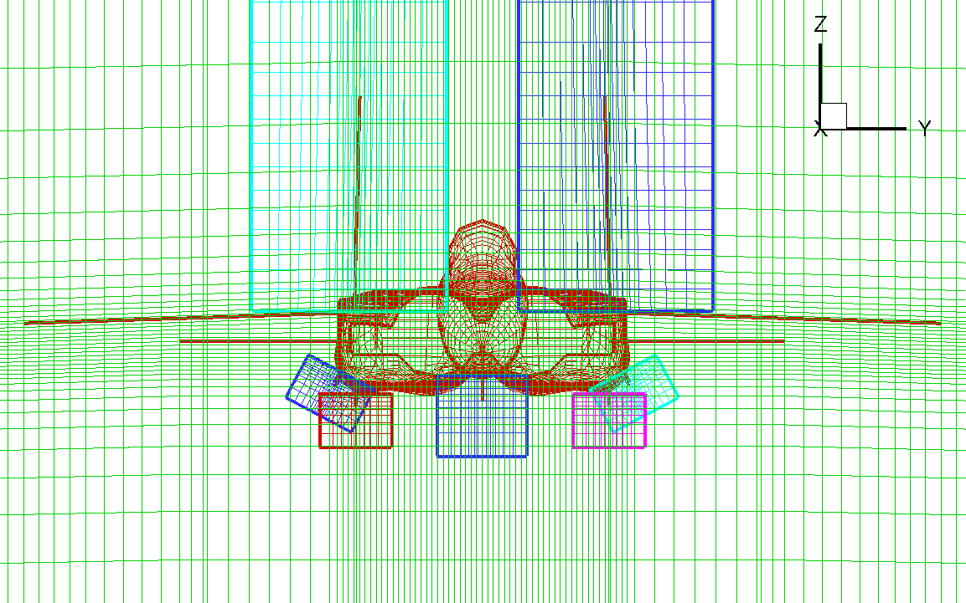
Detailed Panel to ZEUS
Detailed CFD OML

Slide 20
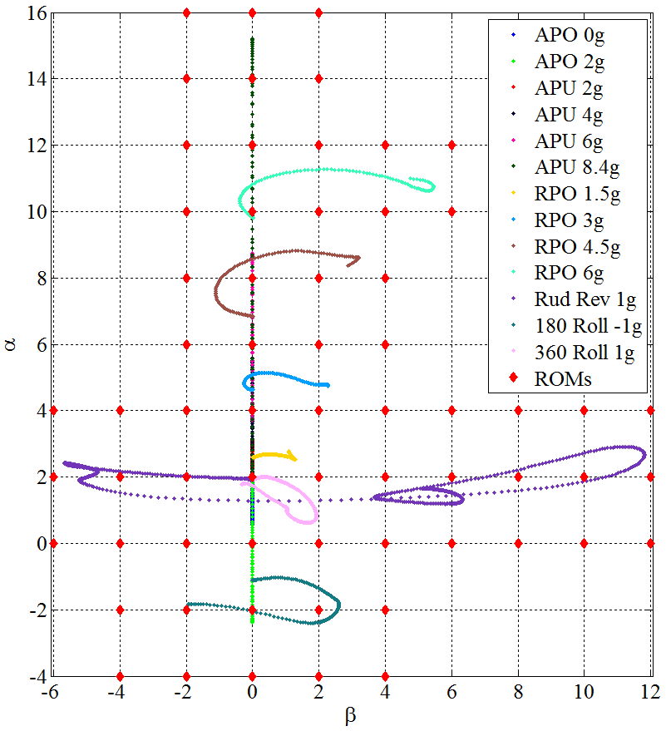
Global FEM to ZEUS to StS-DFS
For each Mach-Altitude “point-in- the-sky”, there is an alpha-beta ROM matrix

Slide 21
MODSDF-StS to OFLCP & FDTS
GAF ROMs
ΔF, ΔM
ON
Cp
Quasi-Steady Component Loads
Dynamic Vehicle States
OFF
Dynamic Component Loads
Dynamic Vehicle States
OFLCP-QS
OFLCP+d
Fatigue Data
Tracking System
Global
FEM Stress
Entire AV

Slide 22
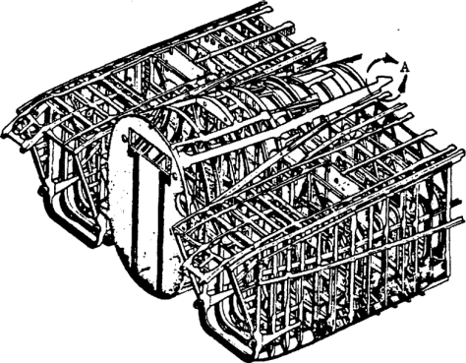
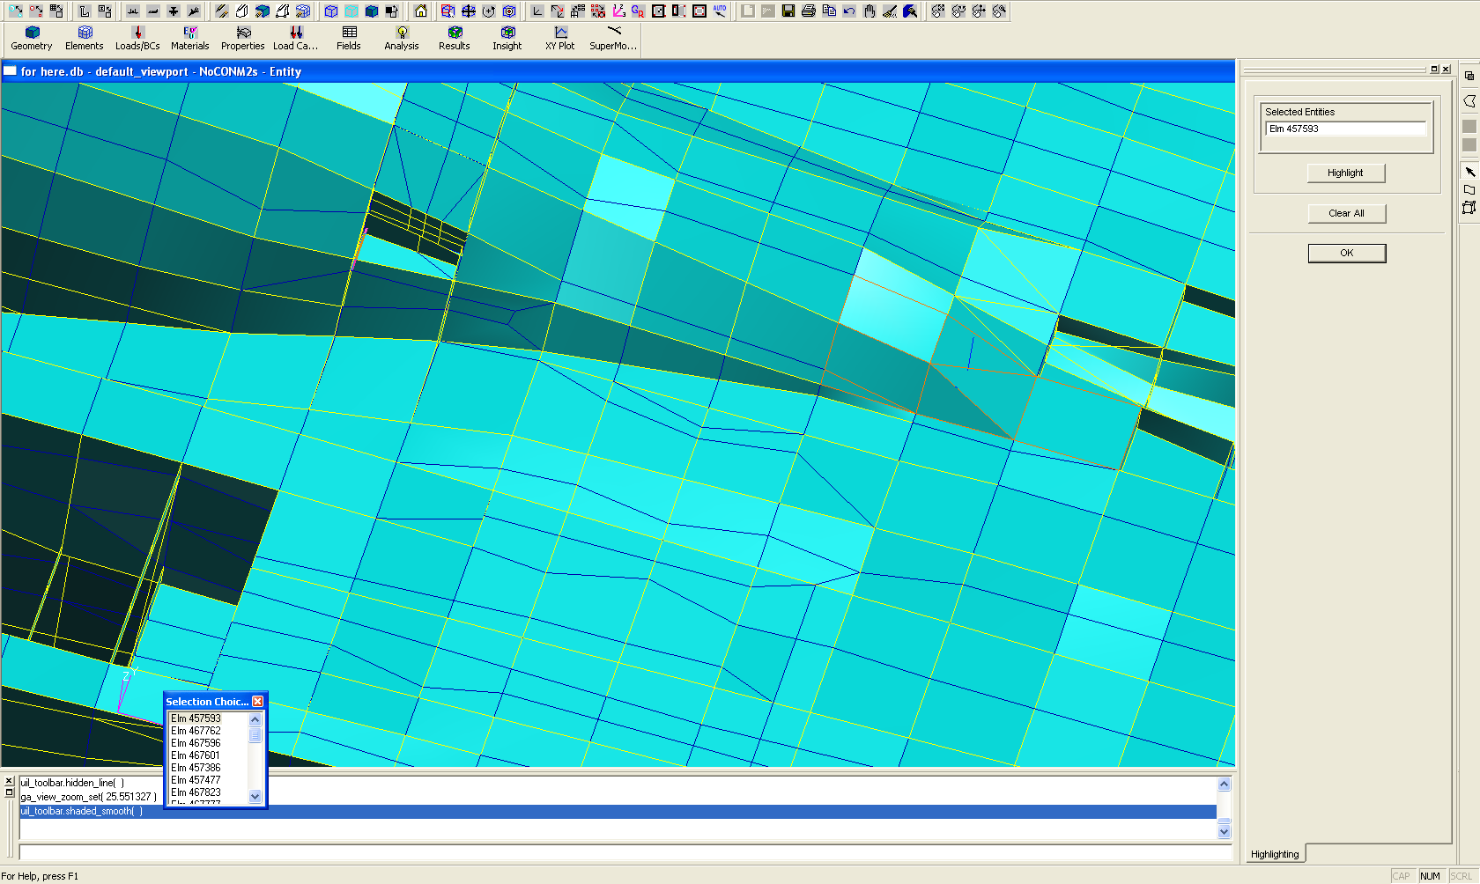
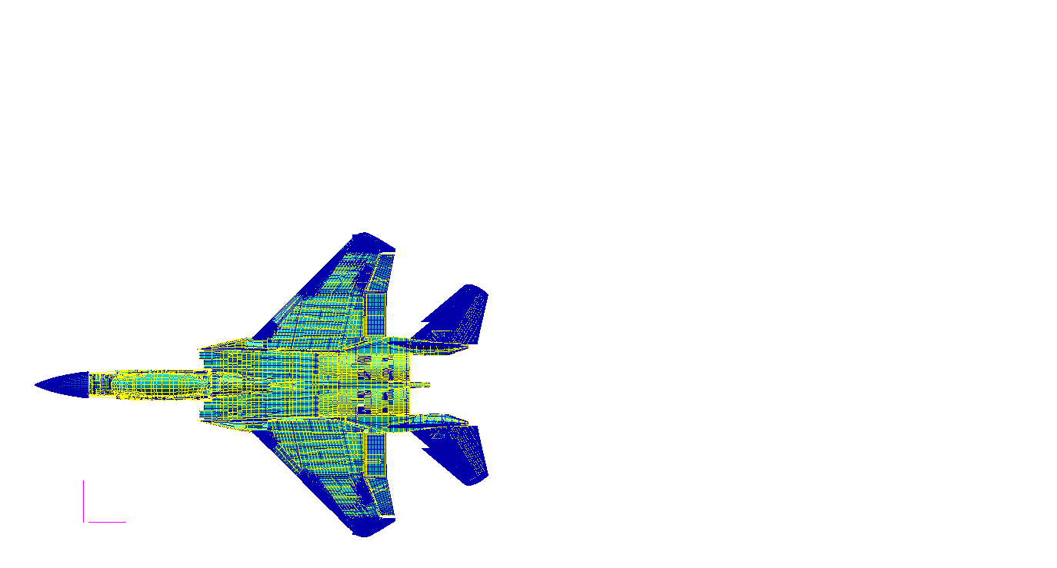
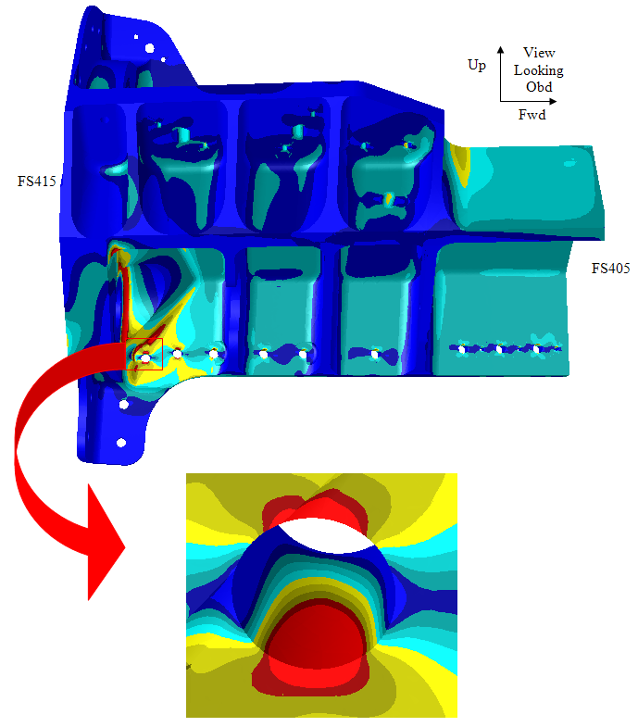
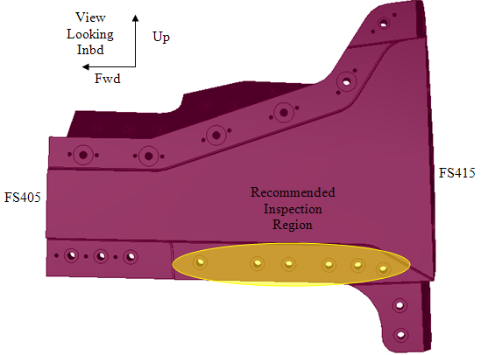
Global to Local, Stress as BC to DADT FEM
Upper Inboard Longeron
Upper Surface
Elements – 457592 474929 474926 475716 475593 475715 458421
Canopy Flange Segment 5 (FS415-FS405)
Crack Growth

Slide 23
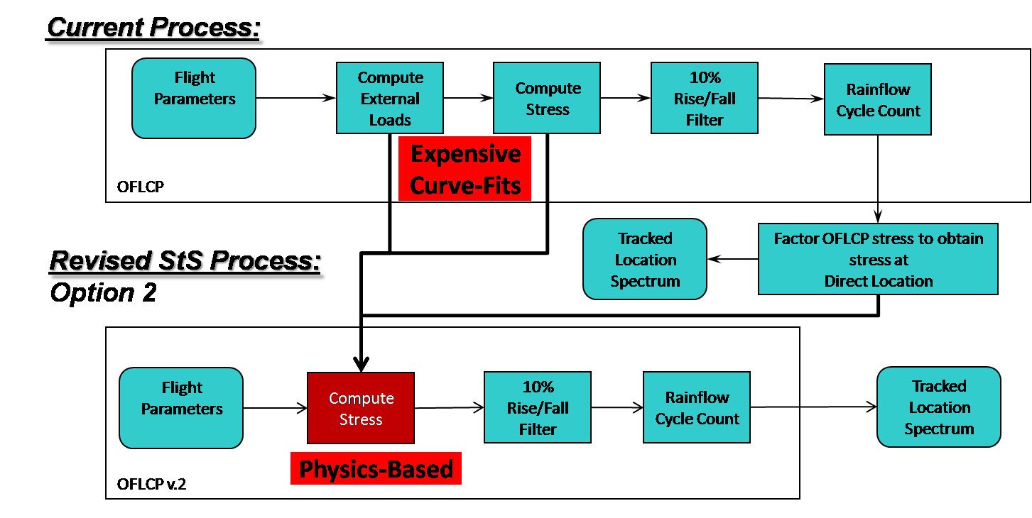
Process Revision, general

Slide 24
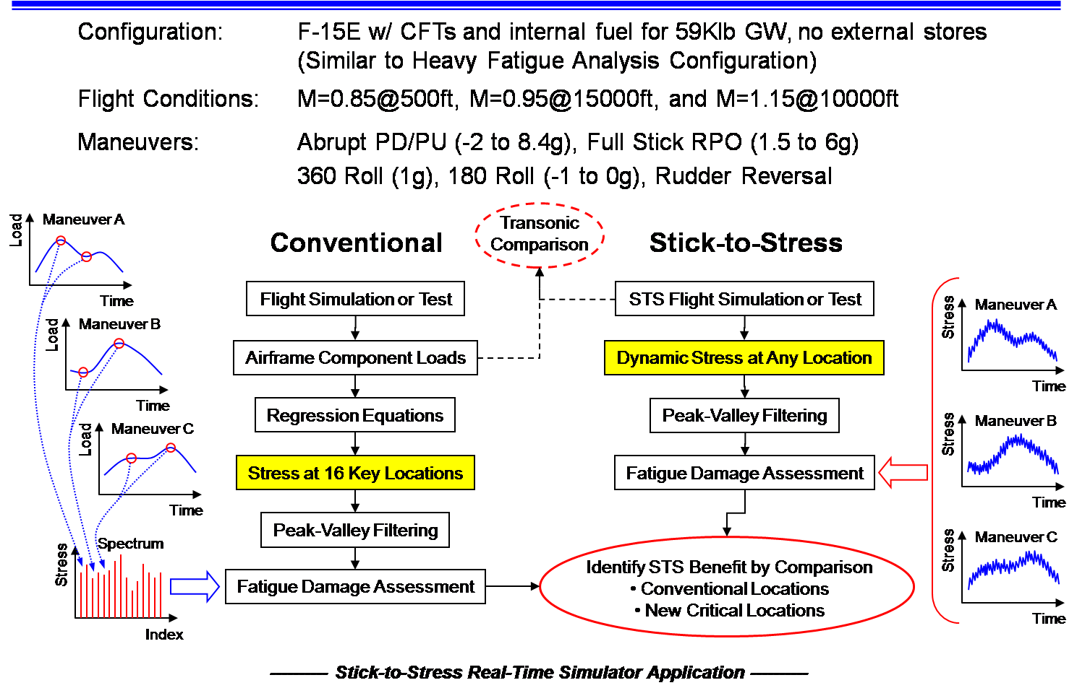
Side-by-Side Comparison

Slide 25
Summary
SOA:
Quasi-steady, empirical, stress-transfer functions (STF)
Expensive to create, utilize and modify
New “hot spots” only from field
Curve-fit the curve-fit, usage severity amplification factors
MODSDF-StS:
Dynamic, physics-based global stresses
Component Load comparison (dynamics included)
Quick comparison for original 16 (and re-fit) location STF
ID global hot-spots using direct dynamic stress
DADT FEM “cut-outs” of these global hot-spots

Slide 26
Notes & Observations
Individual Tail Number FEMs for Detailed Stress will not Change the Modal Basis, No Need to Change MODSDF-StS
Same for Pilot Variation (Maneuver Accomplishment)
Evaluate Pilots in the Simulator for Severity
Control Law Evaluation
Uncertainty Quantification
PROTOTYPE DEVELOPMENT
Variation: Manufacture, Fuel Level, Stores, GVT Update
Transform Cp & GAF ROMs using updated Modal Basis
At What Level Variation must ROMs be Recalculated?
Buffet and Other Highly Separated Flows will Require a Navier Stokes Version of MODSDF-StS

Slide 27
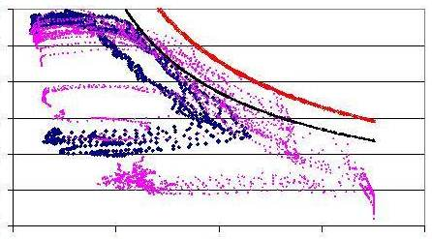
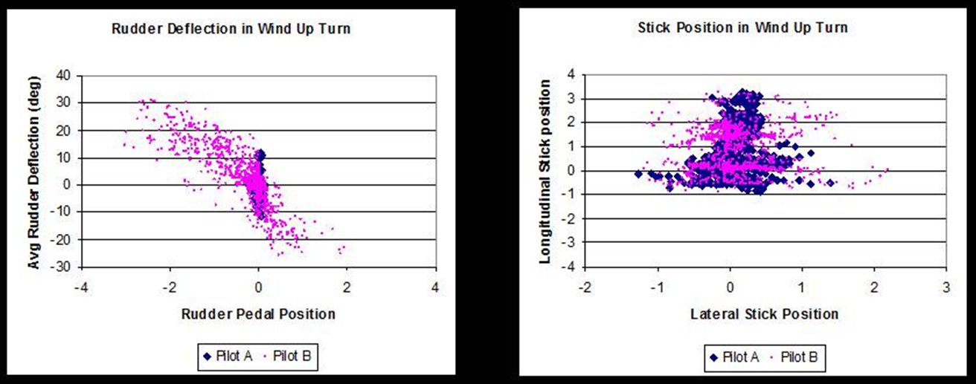
Pilot Variation
Flight Test Buffet Data:
AoA vs. q
Same test points, different approach to flying the maneuver, If you get this much variation in a precision oriented environment imagine the variation in the fleet

Slide 28
Ongoing Work, F-15 C/D Fuselage
Contracting sent SOO on 04/17 for 6.3-199 add on to 6.2-211 effort
ROMs produced will also be used for Airframe Digital Twin Spiral I effort

Slide 29
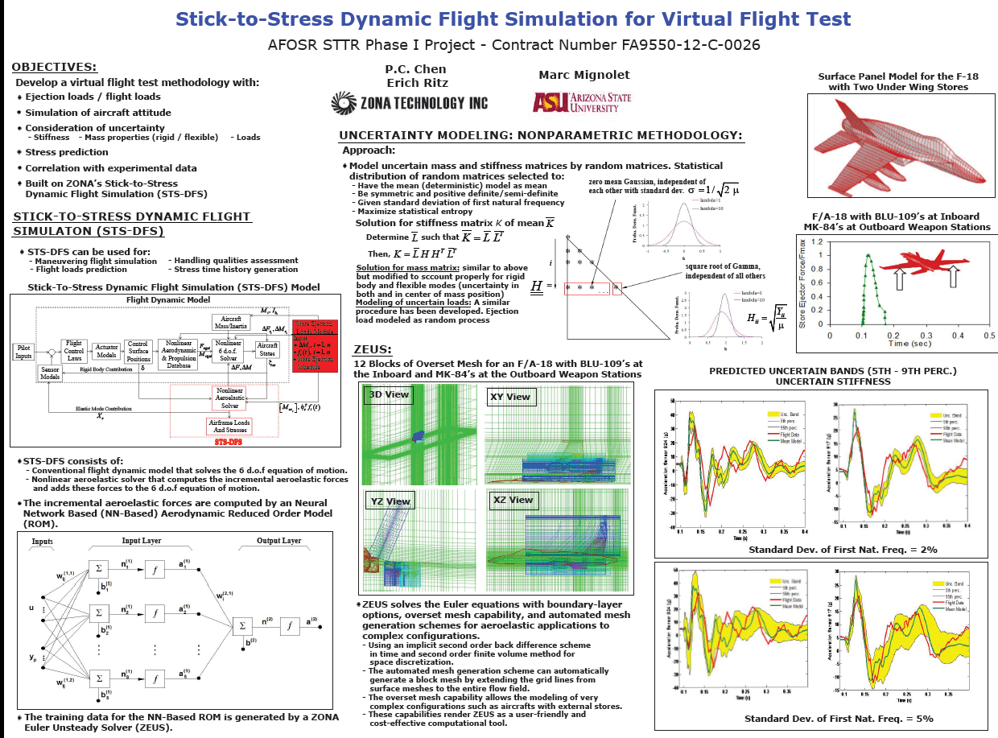
Ongoing Work, Ejection Loads, Structural Variation

Slide 30

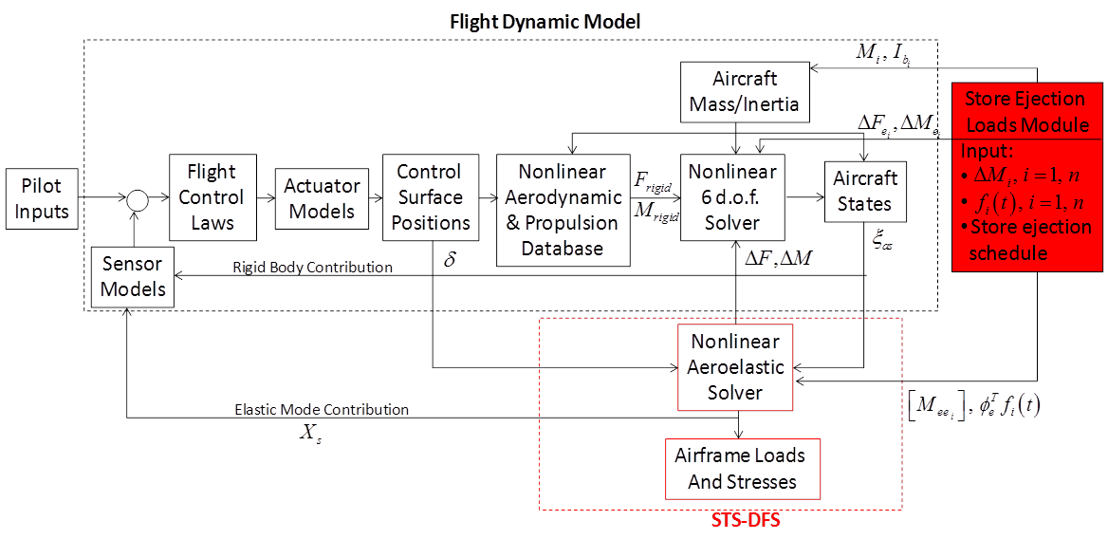
Ongoing Work, Ejection Loads
Marc Mignolet

Slide 31
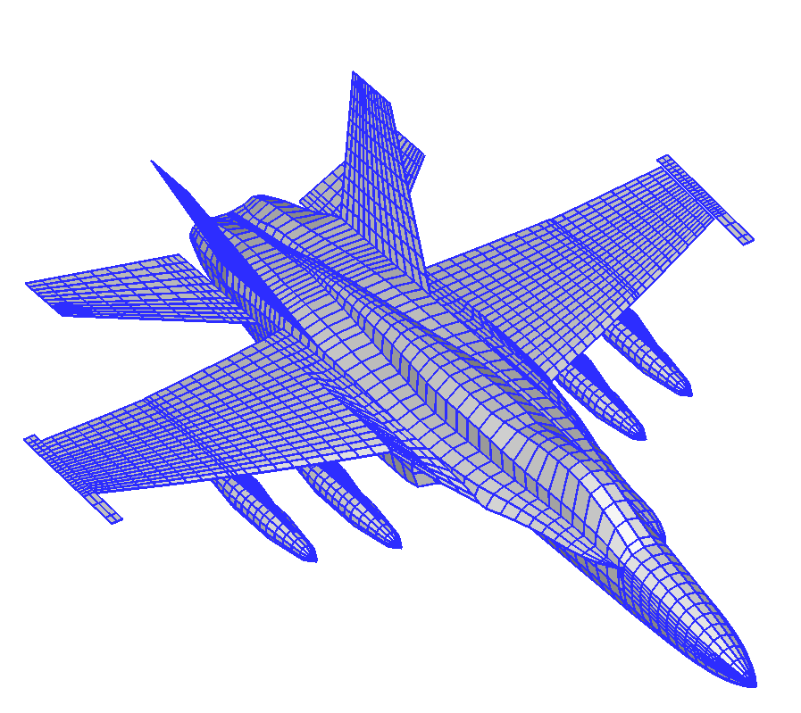
F-18 Inboard MK-84’s Ejection
At M = 0.727, H = 5 kft and 4.23 g Pull-Up

